Slide 1
Master Thesis
Electric Engine Modelling

Slide 2
Objective
To predict 2D and 3D KPIs : Mgrenz(Torque Curve) and ETA(Efficiency Grid) plots for topology invariant IPSM Electric Motors designs.
Regression Problem

Slide 3
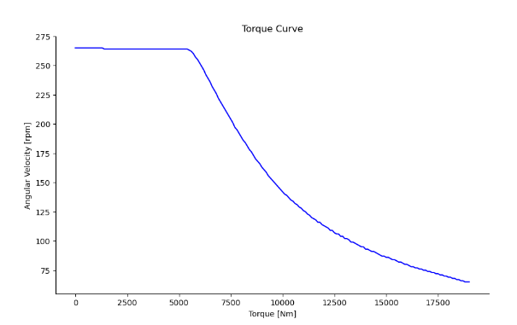
Mgrenz KPI - 2d Plot

Slide 4
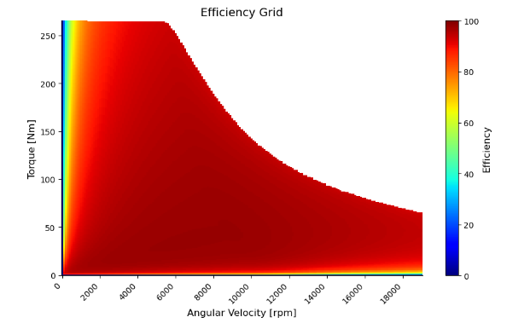
ETA KPI - 3d Plot

Slide 5
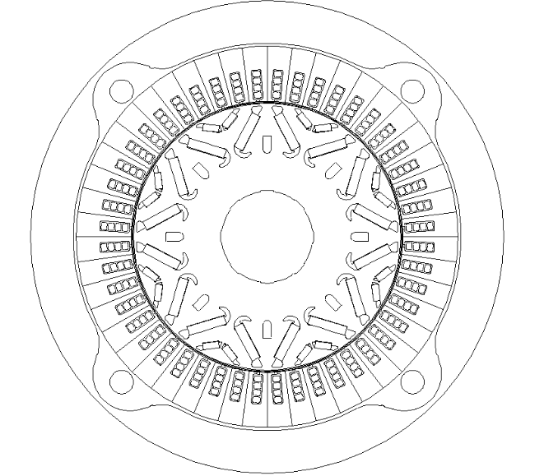
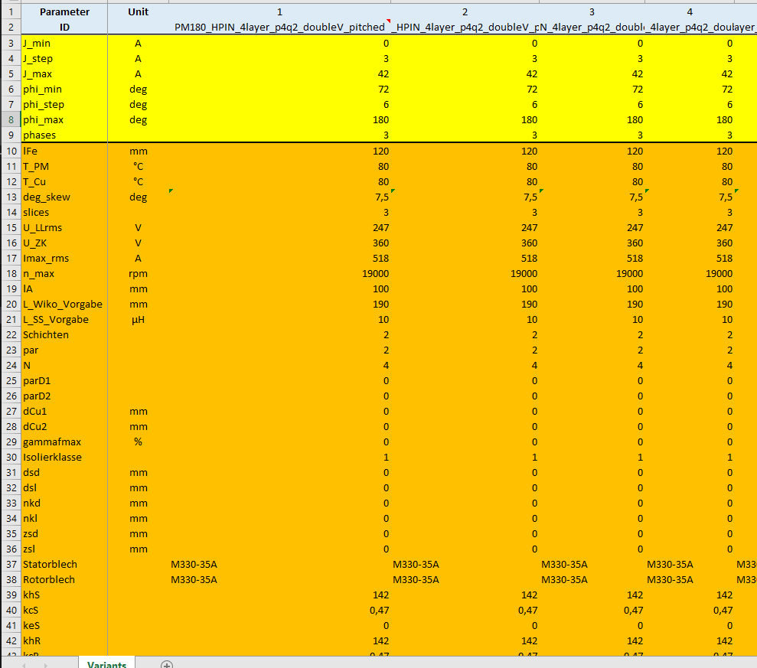
Dataset
Valeo provided ~14810 Double V magnet parametric description

Slide 6
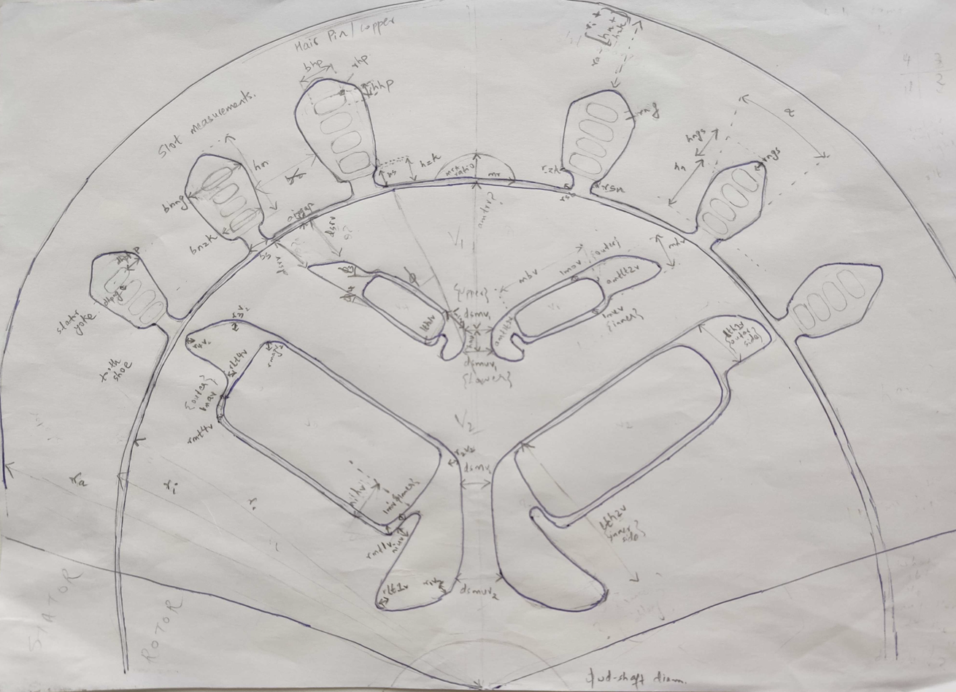
Electric Motor Cross-section

Slide 7
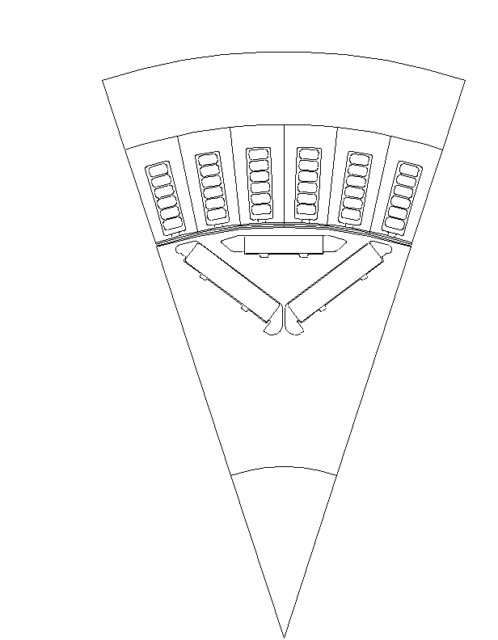
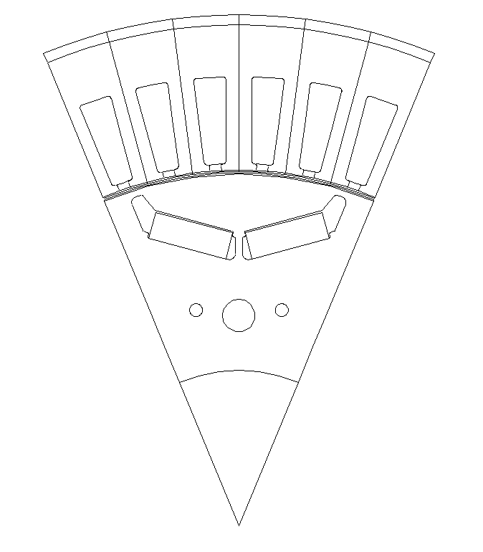
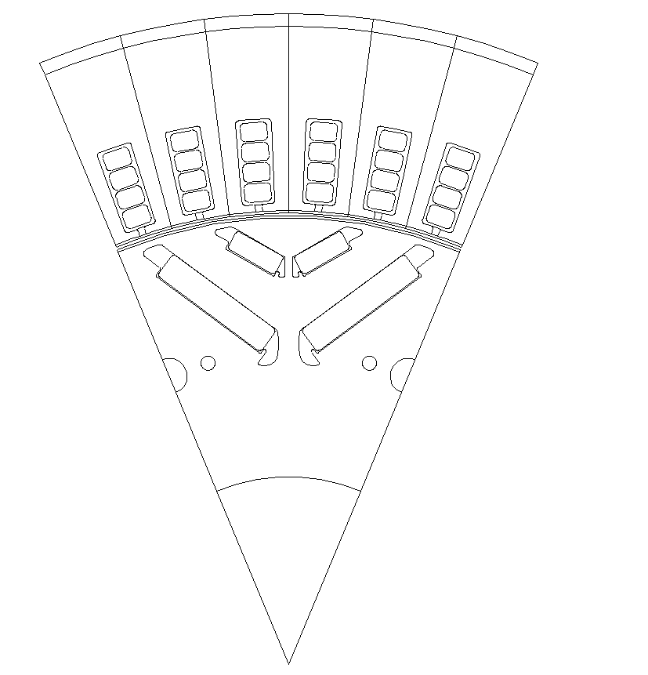
EM Topologies Manufactured by Valeo
Nabla Magnet
Double V Magnet
Single V Magnet

Slide 8
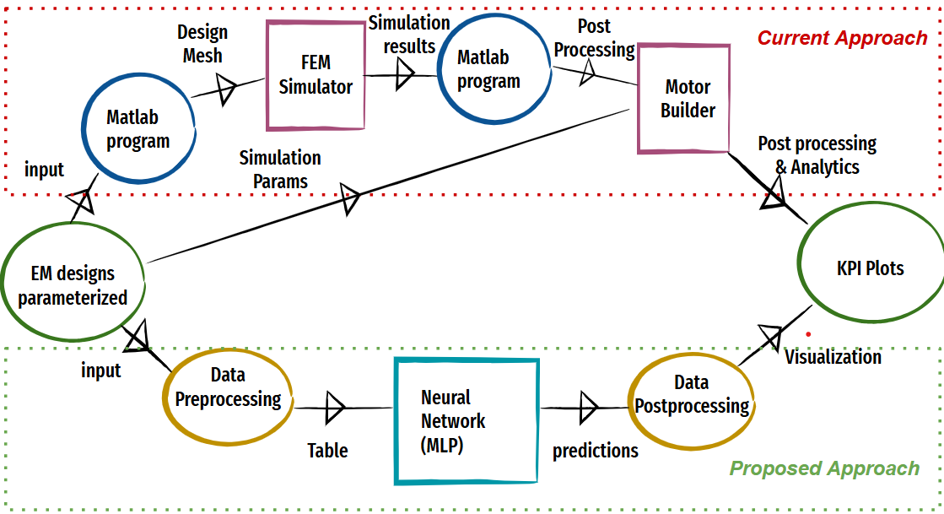
Process Flowchart

Slide 9
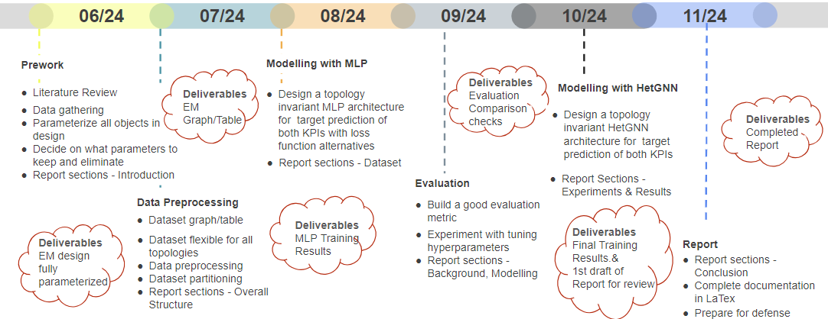
Proposed Timeline

Slide 10
Tabular Representation
Using MLP model
Topology invariance achieved with distinct columns
Geometric connections not explicit
Multiple slots/Magnets/Windings are represented by count as columns

Slide 11
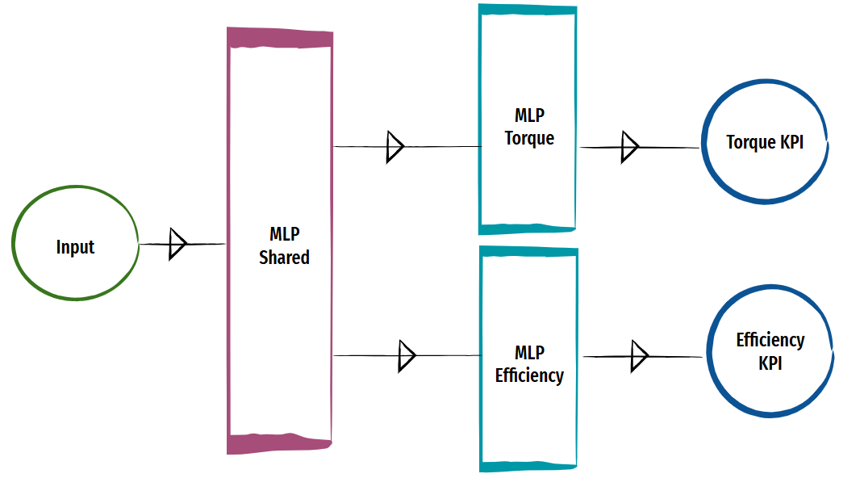
MLP Model

Slide 12
Data Preprocessing
All degree values converted to their corresponding radian values
Only Positive part of ETA grids are considered
All ETA grids padded with the max rows based on Max Mgrenz value
Cross Fold Validation used to have most data for training- 5 folds and best performing model(based on best scores to be chosen for inference

Slide 13
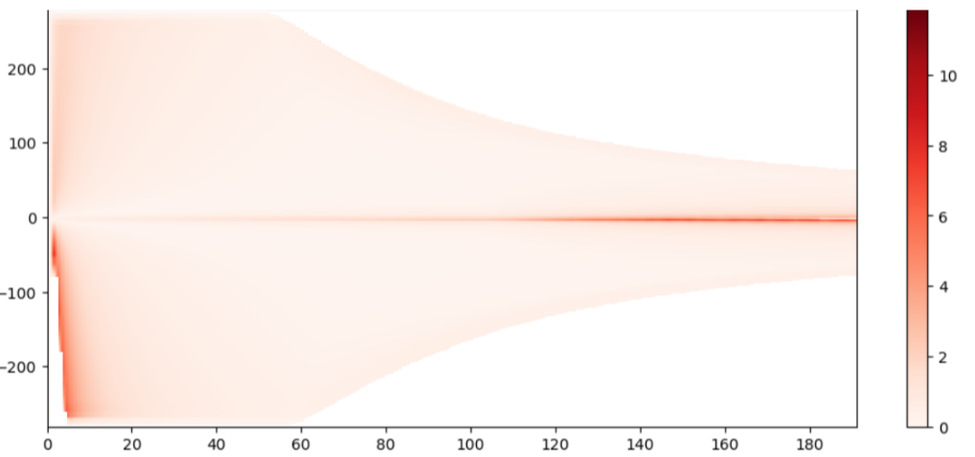
Evaluation Statistics 3D KPI

Slide 14
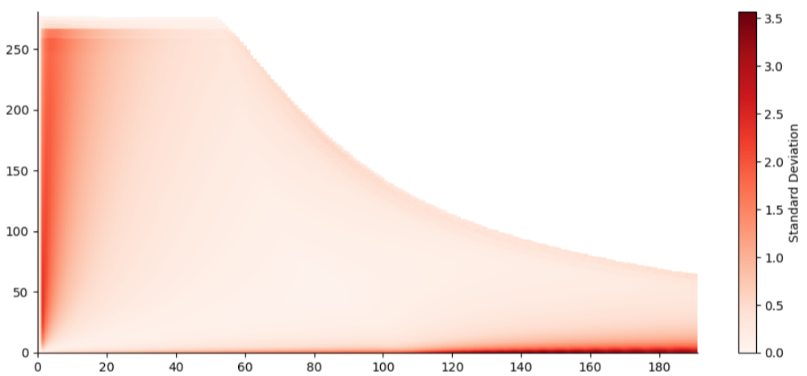
3D KPI(After mirroring ETAs)

Slide 15
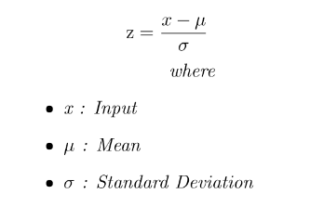
Data Preprocessing
Standard Scaler - Input features

Slide 16
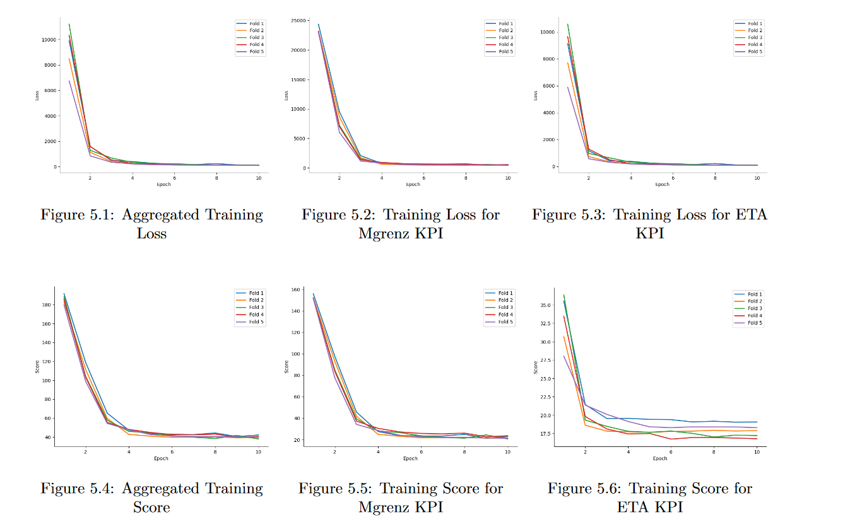
MLP Training Plots

Slide 17
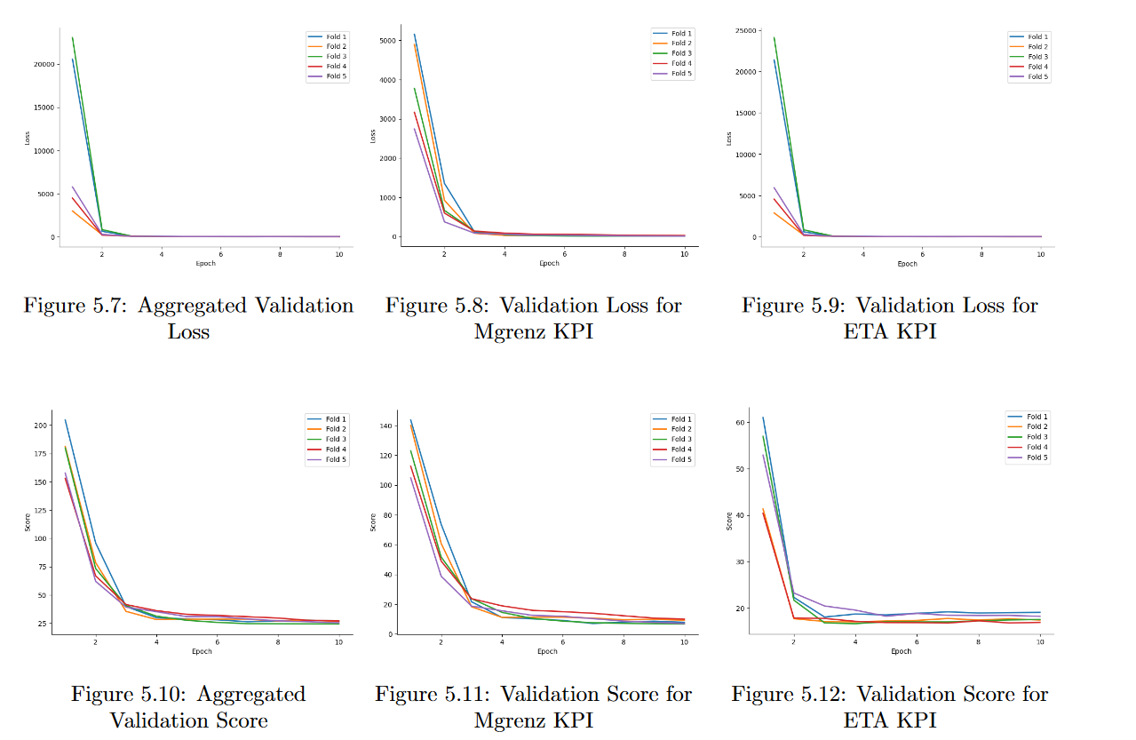
MLP Validation Plots

Slide 18
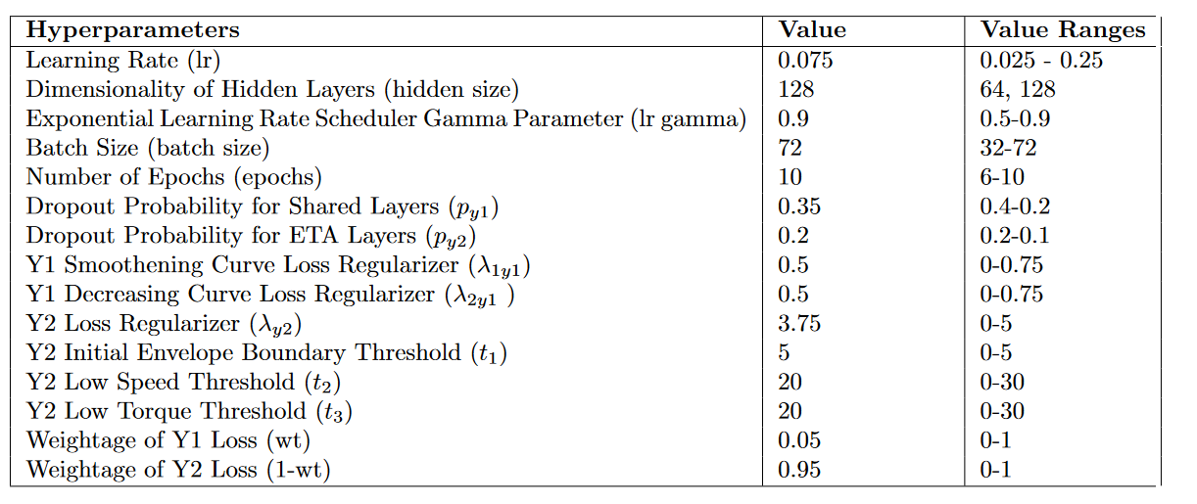
Hyperparameter Tuning

Slide 19
Loss Calculation
Loss : Mean Squared Error

Slide 20
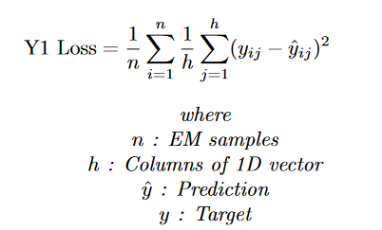
MSE Loss Mgrenz KPI

Slide 21
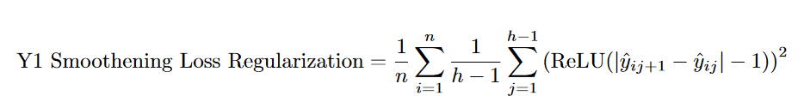
Loss Regularization for Mgrenz KPI
Smoothening Regularization : MSE Loss L2 regularized such that prediction of neighbouring elements in the array is close by.
To encourage stability in the curve with minor to 0 fluctuations

Slide 22
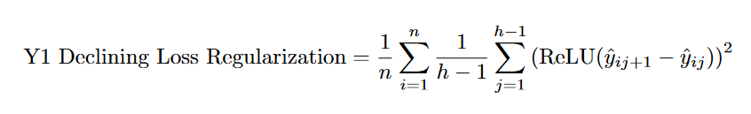
Loss Regularization for Mgrenz KPI
Declining Regularization : MSE Loss L2 regularized such that prediction of a specific element in the array is less than or equal to prior element
To encourage monotonically decreasing array values(as implied by torque curve)

Slide 23
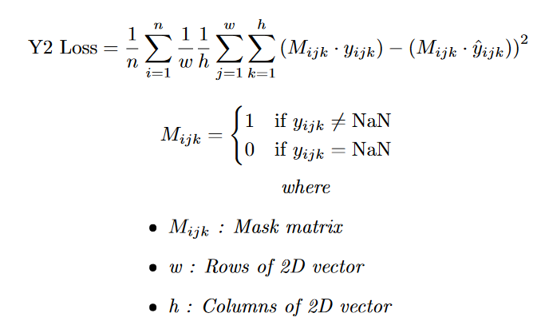
MSE Loss ETA KPI

Slide 24
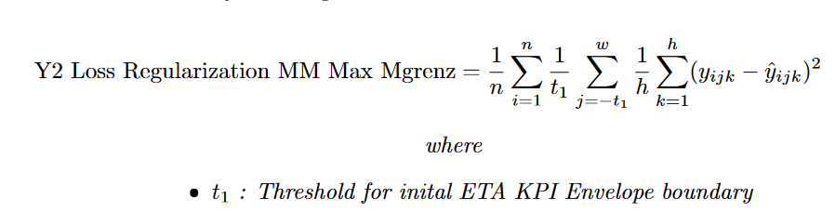
Loss Regularization for ETA KPI
Efficiency at Maximum Torque Loss Regularization

Slide 25
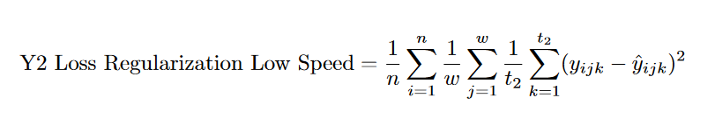
Loss Regularization for ETA KPI
Efficiency at Low Speeds Loss Regularization

Slide 26
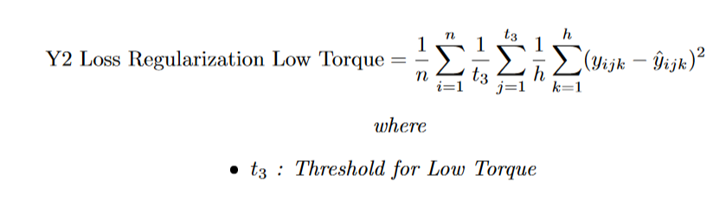
Loss Regularization for ETA KPI
Efficiency at Low Torque Loss Regularization

Slide 27
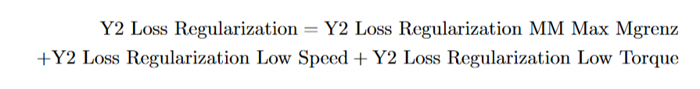
Loss Regularization for ETA KPI

Slide 28
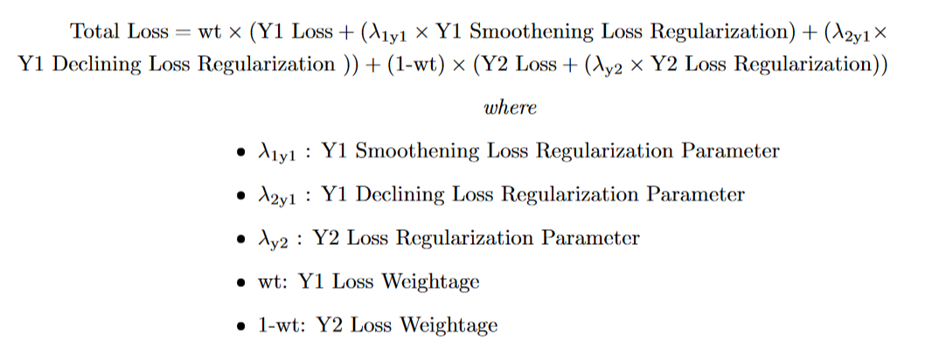
Total Loss

Slide 29
Post Processing
Scale input with same scale used for training
Once ETA predictions are obtained, slice them based on shape of its corresp Torque curve

Slide 30
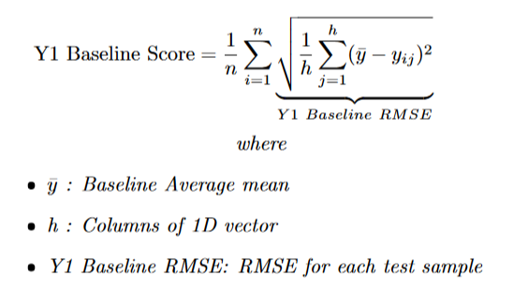
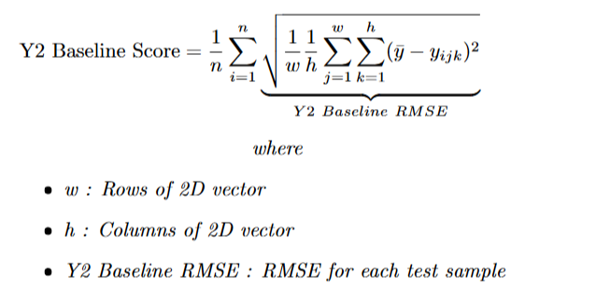
Baseline Model
Averaged Test Dataset for both outputs

Slide 31
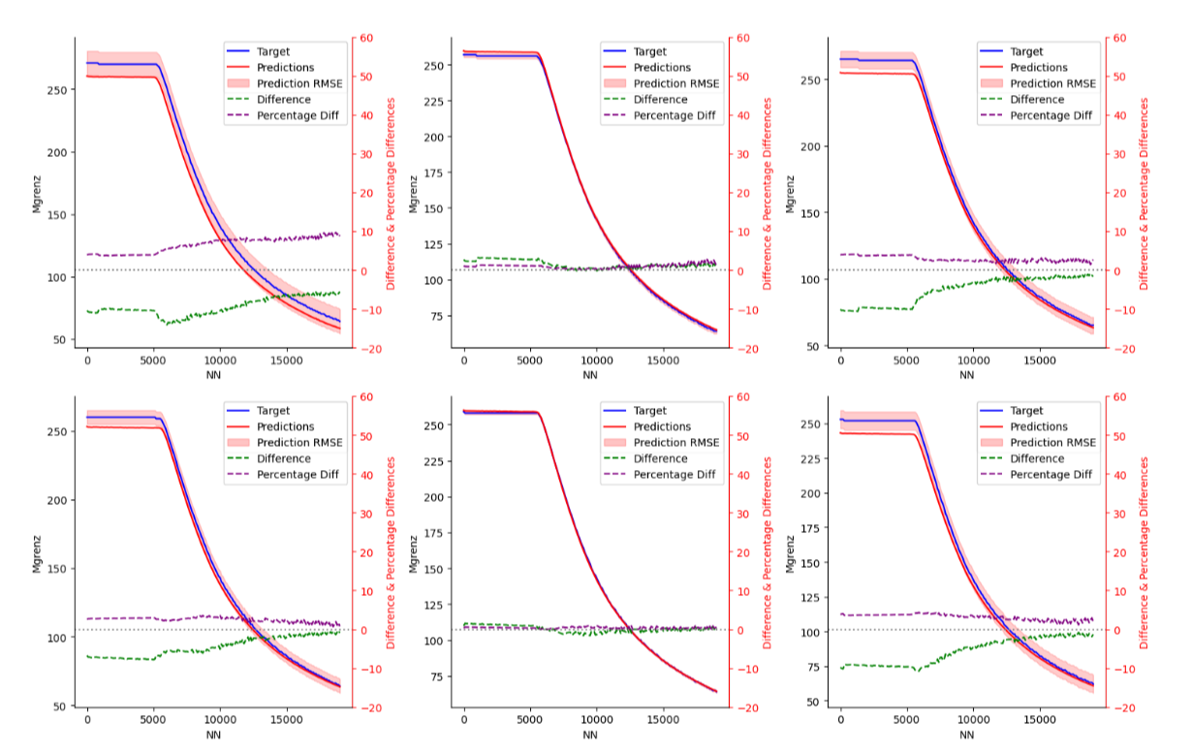
MLP Training Results for KPI prediction Mgrenz

Slide 32
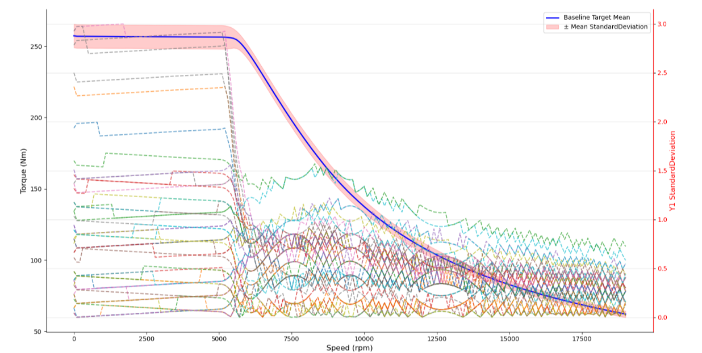
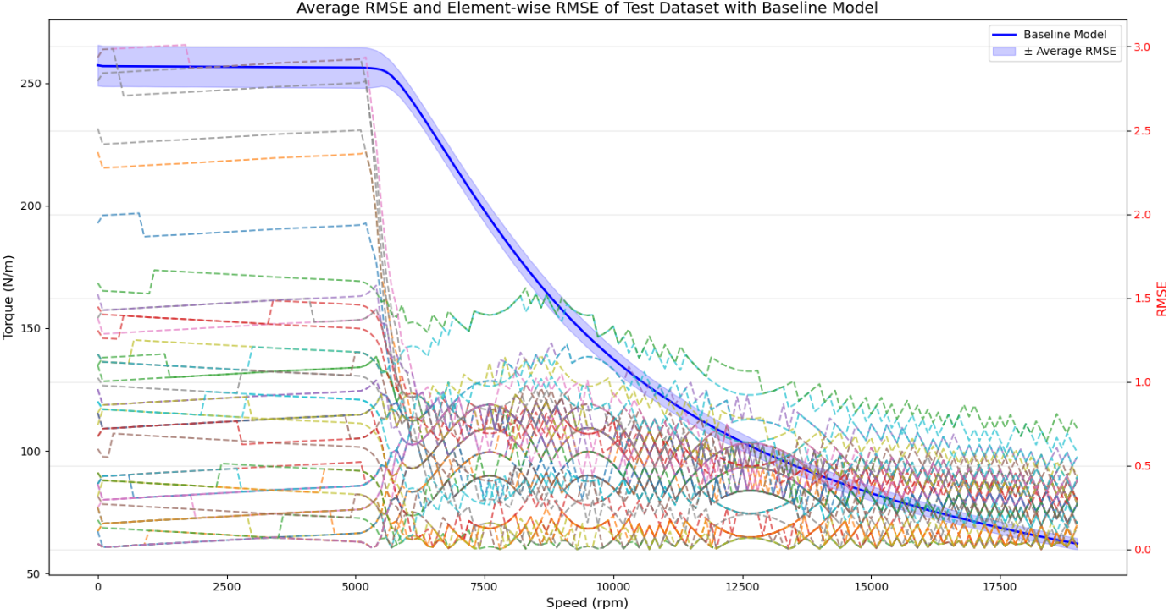
Standard Deviation of Random Engines from Whole Dataset

Slide 33
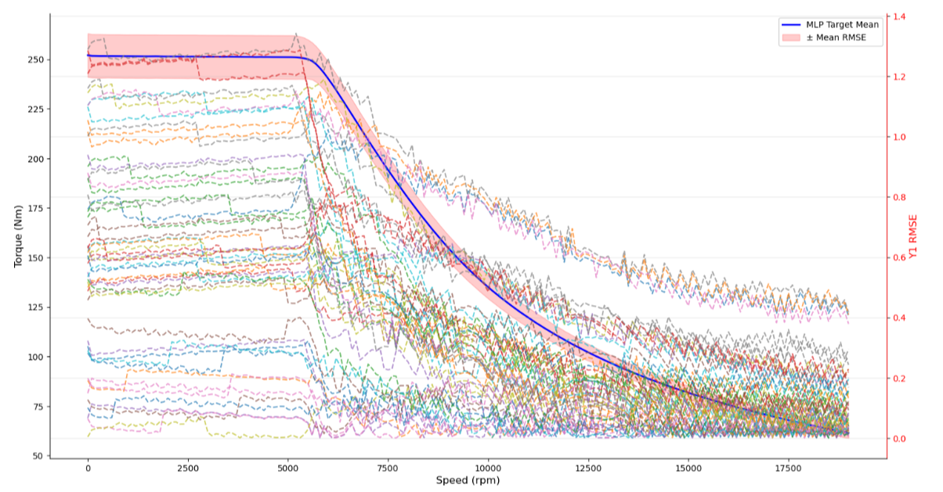
MLP Training Results for KPI prediction Mgrenz

Slide 34
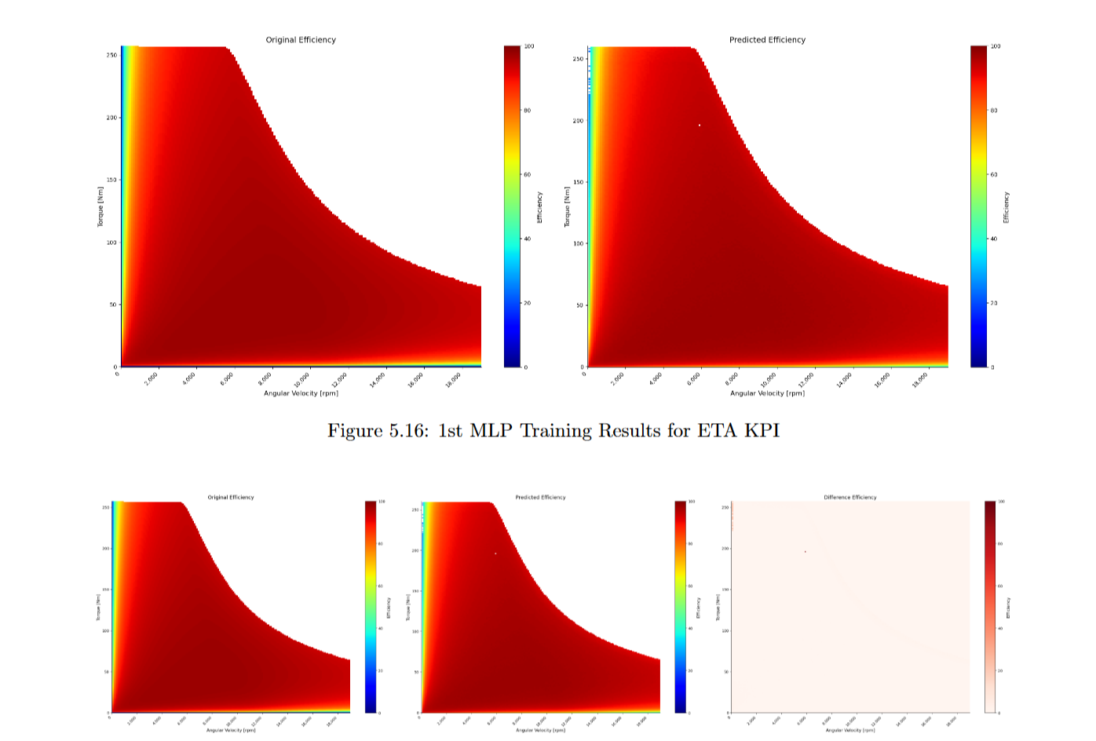
MLP Training Results for KPI prediction ETA

Slide 35
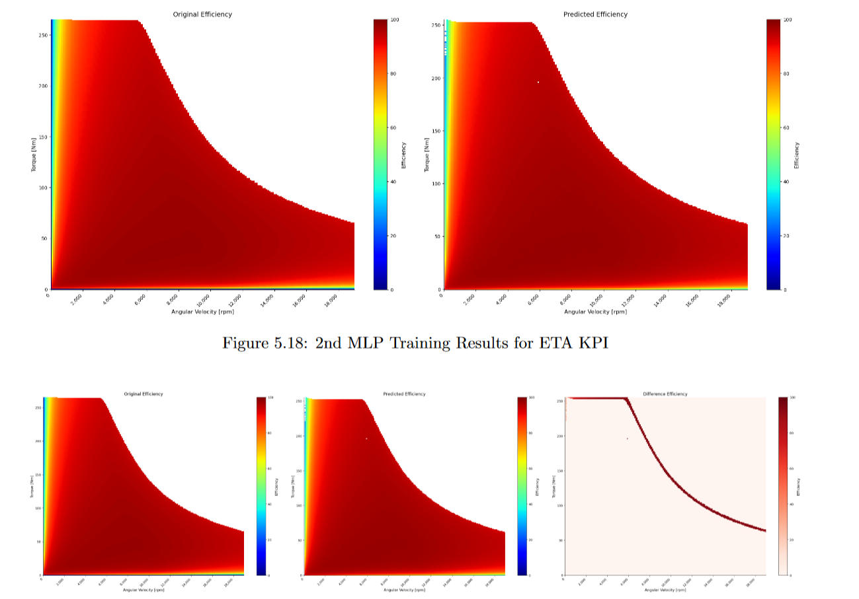
MLP Training Results for KPI prediction ETA

Slide 36
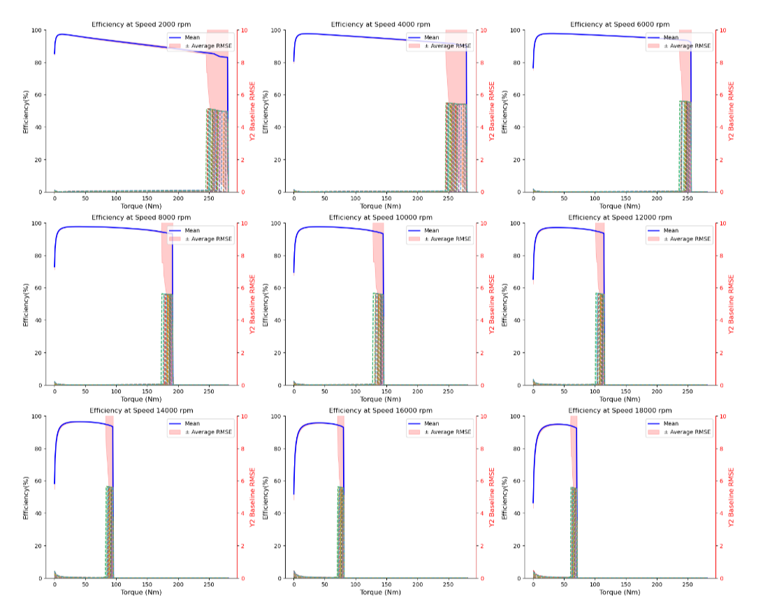
Baseline RMSE for KPI prediction ETA

Slide 37
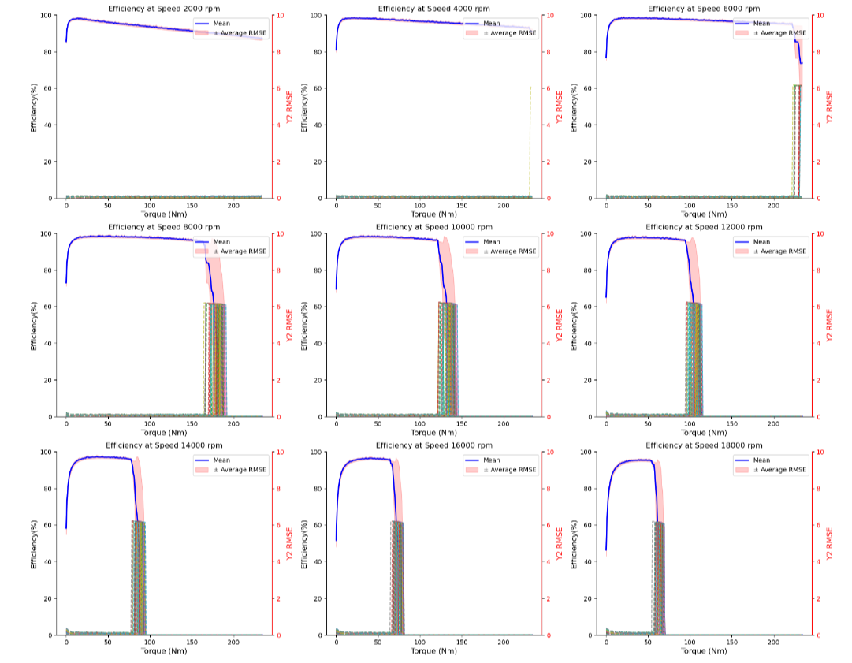
MLP RMSE for KPI prediction ETA

Slide 38
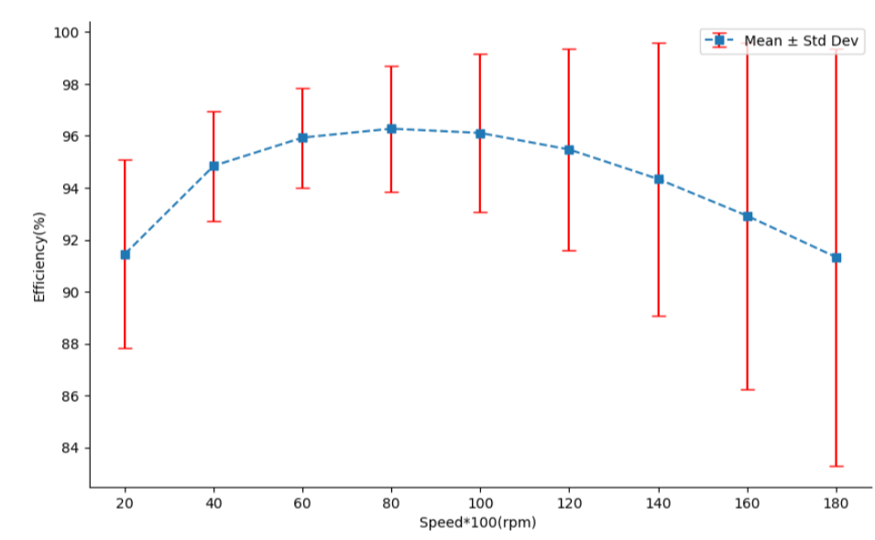
Standard Deviation of few ETA samples from Whole Dataset

Slide 39
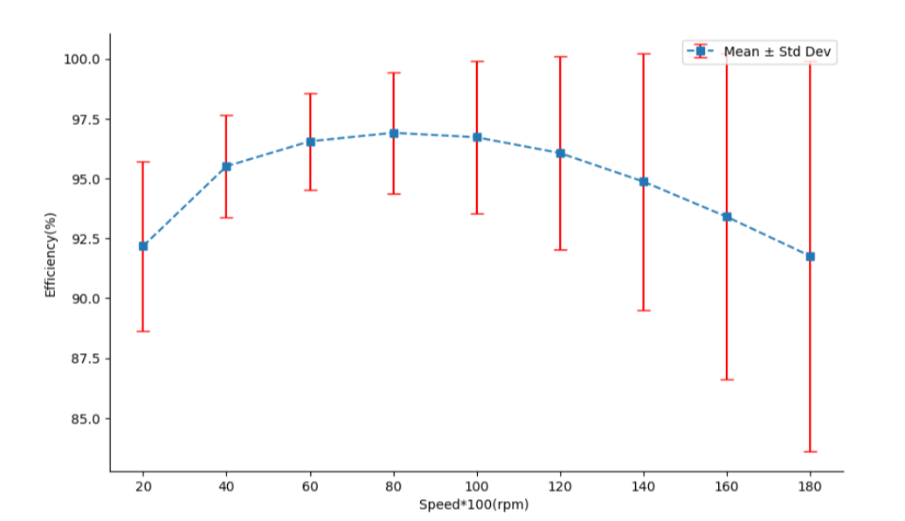
MLP Training Results Standard Deviation for few Predictions

Slide 40
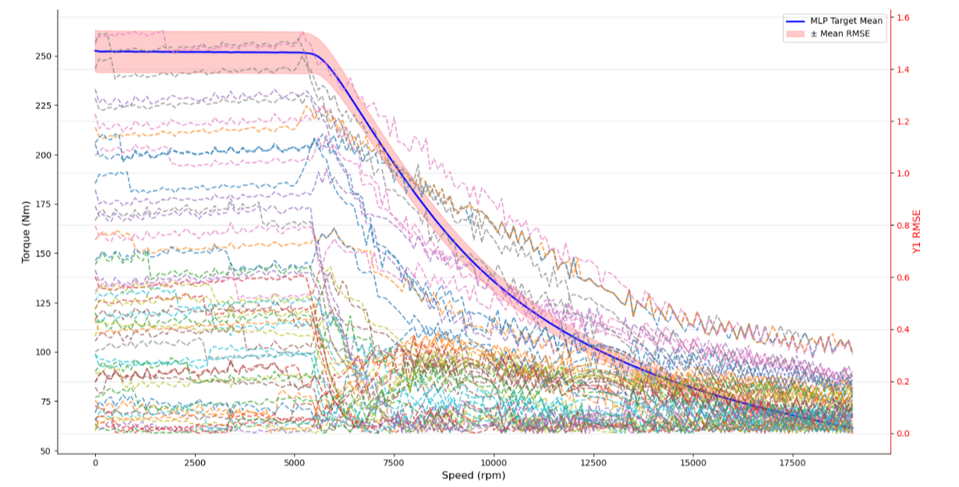
MLPb Training Results for KPI prediction Mgrenz

Slide 41
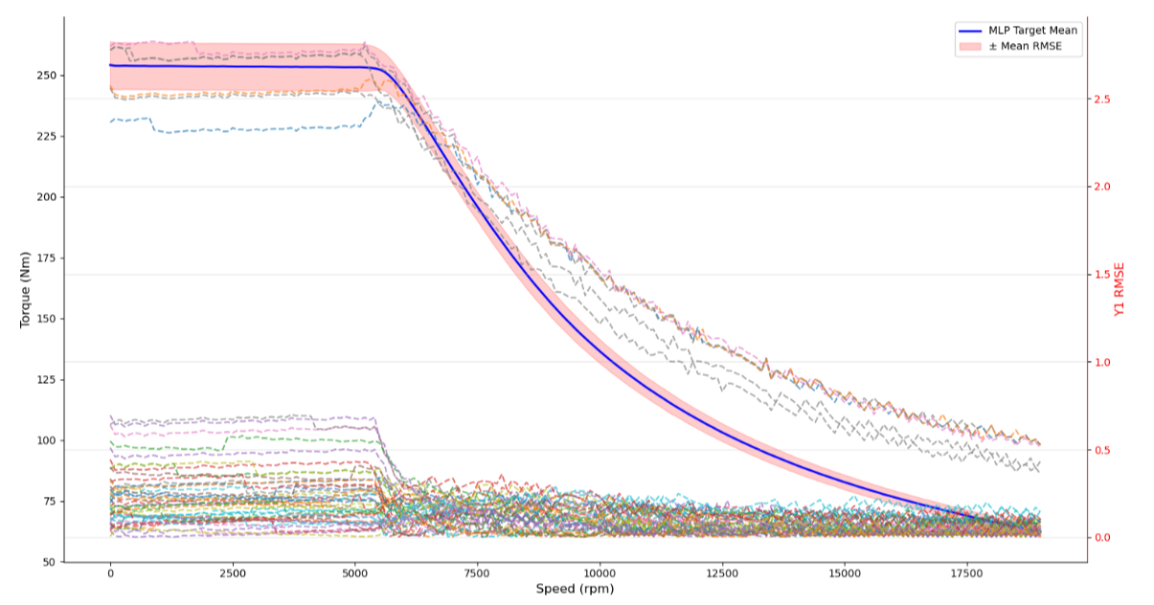
MLPc Training Results for KPI prediction Mgrenz

Slide 42
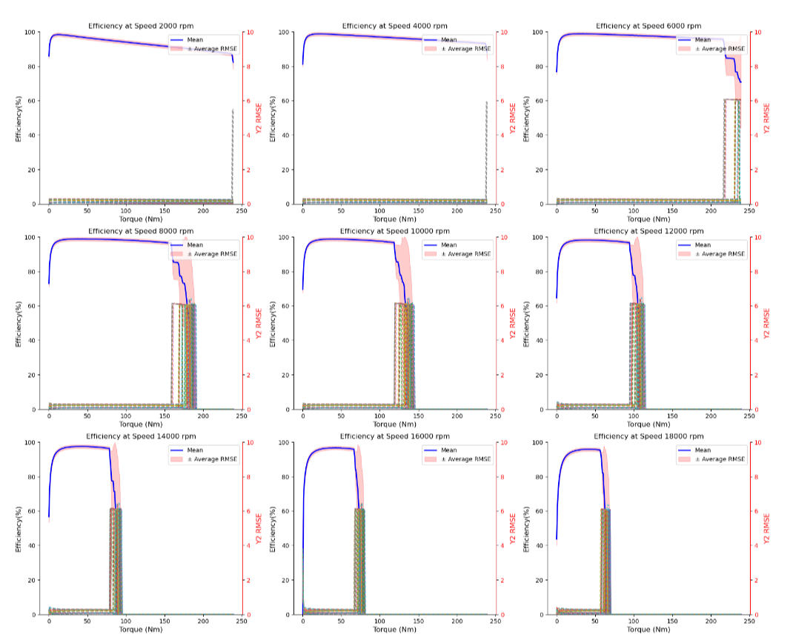
MLPc RMSE for KPI prediction ETA

Slide 43
Evaluation Metrics
RMSE as a Score for both KPIs
Difference and Percentage Difference for Mgrenz KPI and Difference for ETA KPI

Slide 44
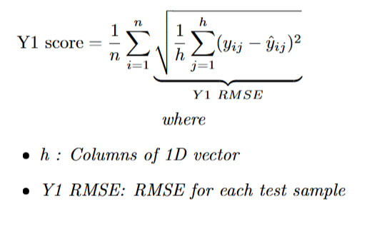
Evaluation Metric for Mgrenz KPI

Slide 45
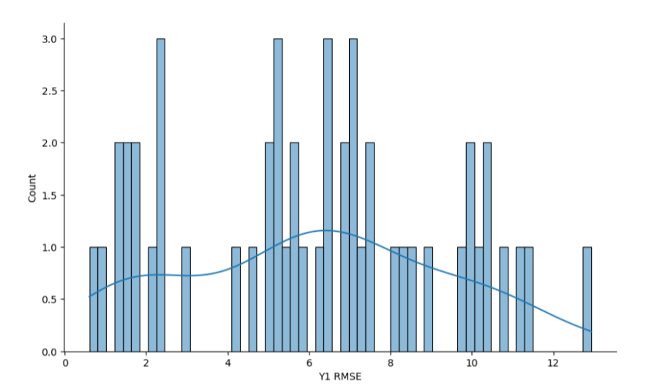
Evaluation Statistics Mgrenz KPI

Slide 46
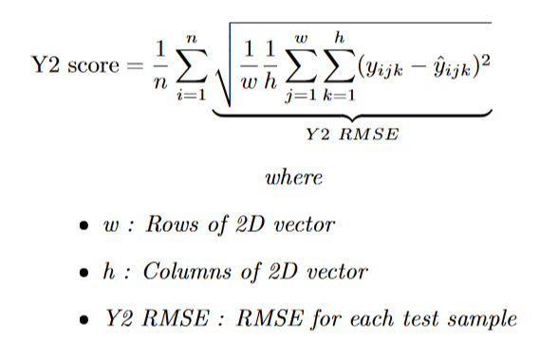
Evaluation Metric for 3D KPI

Slide 47
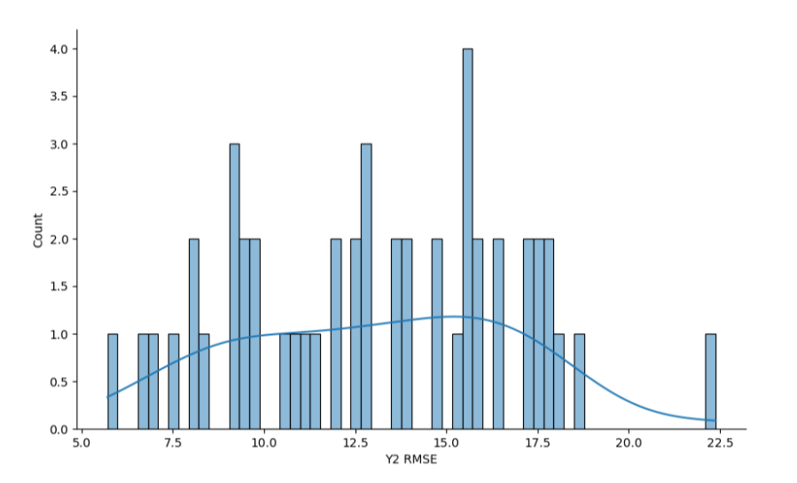
Evaluation Statistics ETA KPI

Slide 48
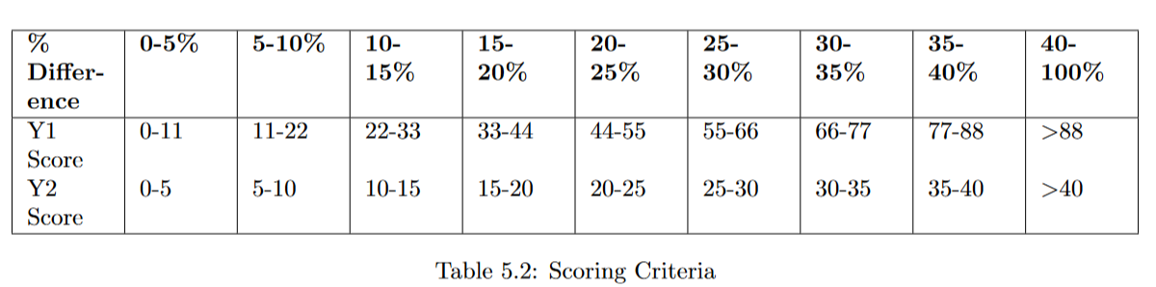
Scoring Criteria

Slide 49
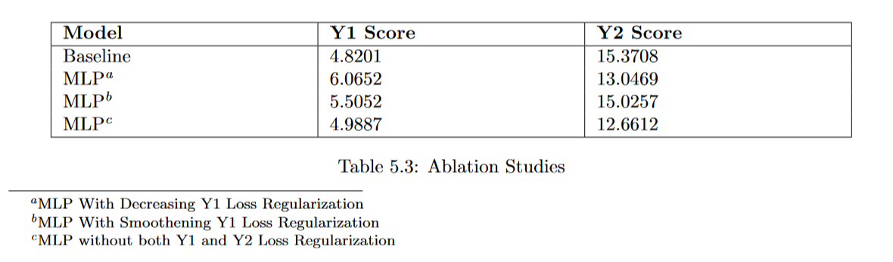
Ablation Studies

Slide 50
Case Study

Slide 51
GNN
GNNs aim to learn a representation vector for each node after L layer transformations based on graph structure and initial node feature
Representation of each node is computed by recursively aggregating features of neighbour nodes
These relations can be composited with each other to learn high level semantic relations - Metapaths

Slide 52
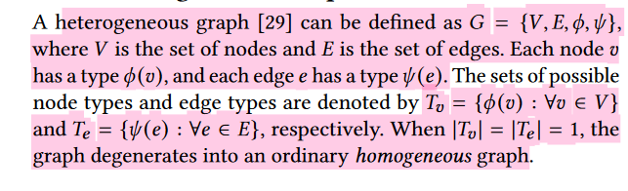
GNN
2 types :
Homogeneous GNN
Heterogeneous GNN

Slide 53
Purposes
Node Prediction
Edge Prediction
Graph Prediction

Slide 54
Applications
Recommendation Networks
Academic Networks
Information Networks
Social Networks
Generally involves 1 giant graph - hence the importance of going graph batch, splits etc.
Our use case : 1 graph per EM variant

Slide 55
Graph Representation
2 types :
Metapath based HGNN
Capture structural info of same semantic and then fuse diff semantic info
Metapath Free based HGNN
Capture structural and semantic information simultaneously

Slide 56
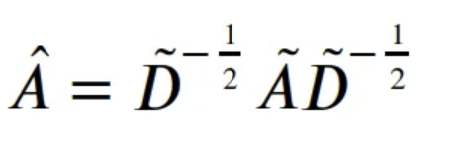
Message Passing

Slide 57
Homogeneous GNN Message Passing
As node and edge are of same type.
MP is done over neighbouring nodes and edges over hops until it learns a representation equivalent from its neighbours

Slide 58
Heterogeneous GNN Message Passing
Node & Edge features from different types cannot be processed by same function due to difference in feature type and / or dimensionality
Therefore MP functions need to be implemented individually for each edge type.
MP GNN algorithm need to iterate over edge type dictionaries during message computation and over node type dictionaries during node updates

Slide 59
OverSmoothing & Gradient Vanishing
GNNs cannot be too deep due to oversmoothing problem.
Impedes model training by isolating output representations from the input features with increase in depth
Mitigate by including pre activation residual connections

Slide 60
Graph Representation
Using Hetereogeneous GNN model
Represent data as graph - networkx graph
Topology invariance to be achieved here by having different nodes and edges but node and edge type always would remain consistent
Geometry is much better represented
Multiple slots/Magnets/Windings are represented as different nodes
Apt for our usecase

Slide 61
Double V Magnet Topology
Node Types
{v, vm, r, s, sw}
Edge Types
{a, d1, d2, d4}

Slide 62
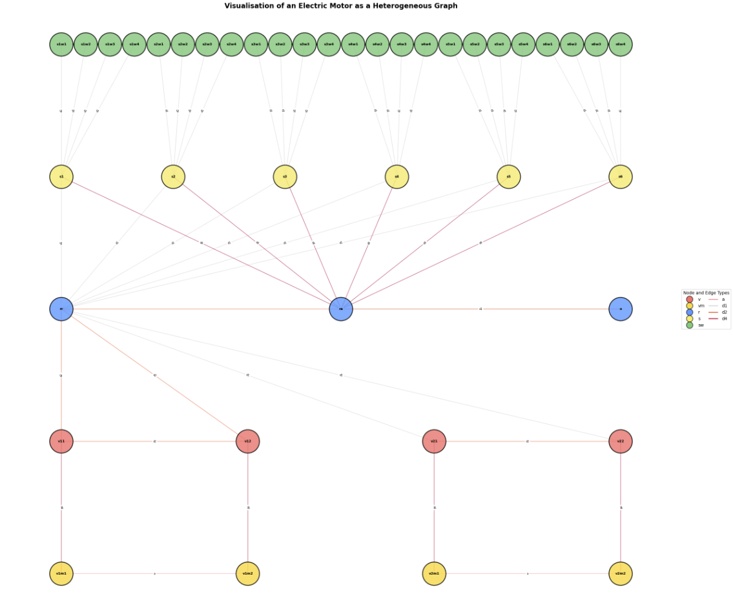

Slide 63
Scaling
Standard Scaling for each node type and edge type

Slide 64
Mapping
Node Mapping
Edge Mapping

Slide 65
Modelling
Linear Layer for each Node type
Convolutional layer for each edge type
Presumably another Linear layer for each Edge feature

Slide 66
Thank you

